Slide 1
CS 341 Lab introduction
Fall 2020

Slide 2
Contact Info
Email me for grades or if you would like to setup a 1:1 meeting (jack.davis001@umb.edu)
Office Hours: by appointment only (send an email and we can setup a zoom meeting)

Slide 3
Weekly Meetings
Starter code is available on GitHub: https://github.com/jack17davis/cs341
Step-by-step instructions will be posted on https://www.cs.umb.edu/~cheungr/cs341/
Lab introduction
Working lab demonstration
Q&A
Breakout rooms for real-time labs
Use the “help” button to get my attention
You are welcome to take longer or leave early
Lab report is due by the start of the next lab (typically a week)

Slide 4
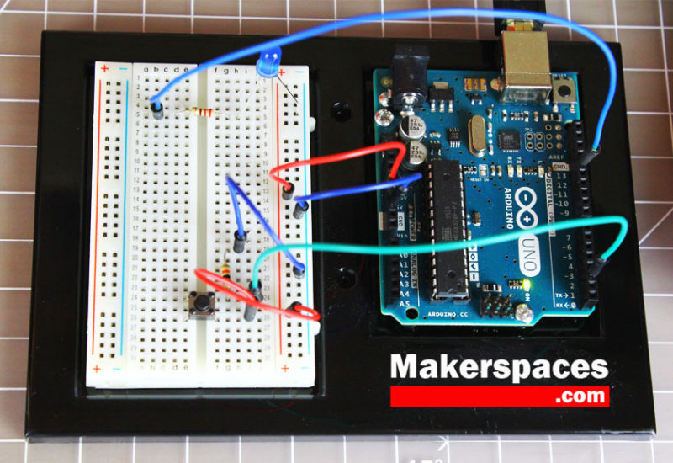
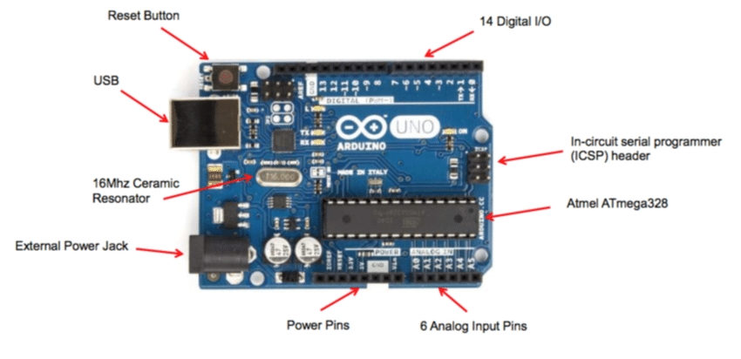
Arduino

Slide 5
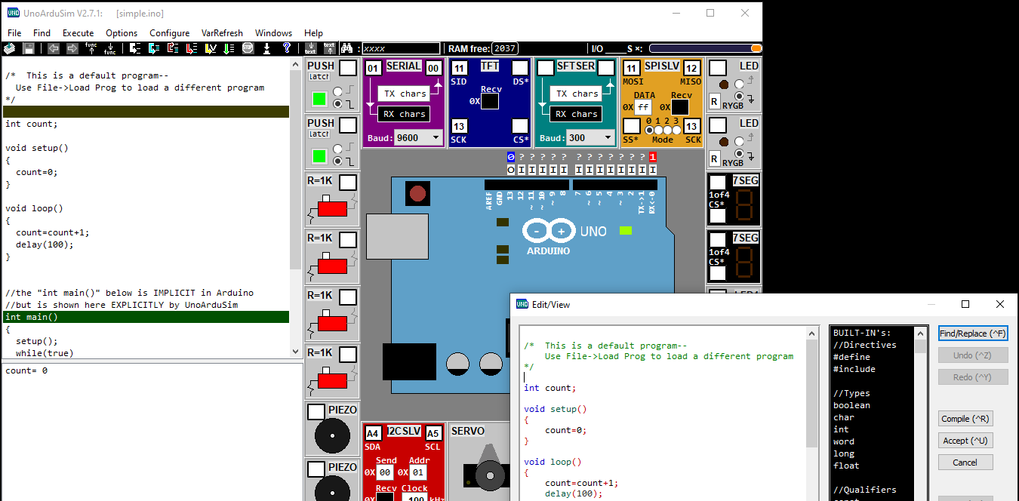
UnoArduSim

Slide 6
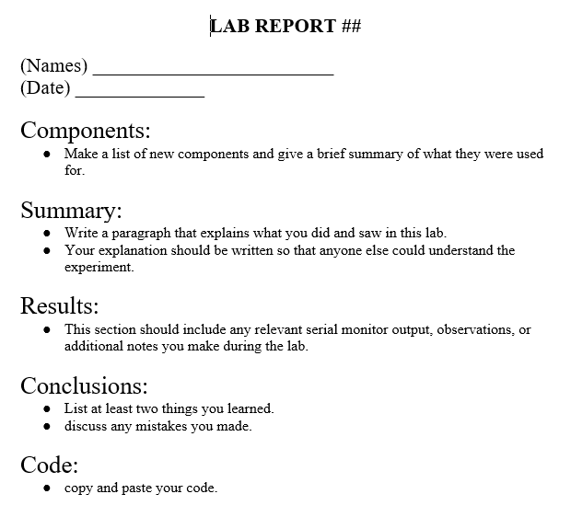
Lab Report Template
Labs can be written and submitted as a team
Submit by email to jack.davis001@umb.edu before your sections next meeting
There will be 10 labs
I’ll be grading each lab out of 10:
5 points for submitting the lab report on time
3 points for quality of lab report
2 points for code that works correctly
If you can’t get your code working in time, please document what you tried and submit the lab anyway

Slide 7
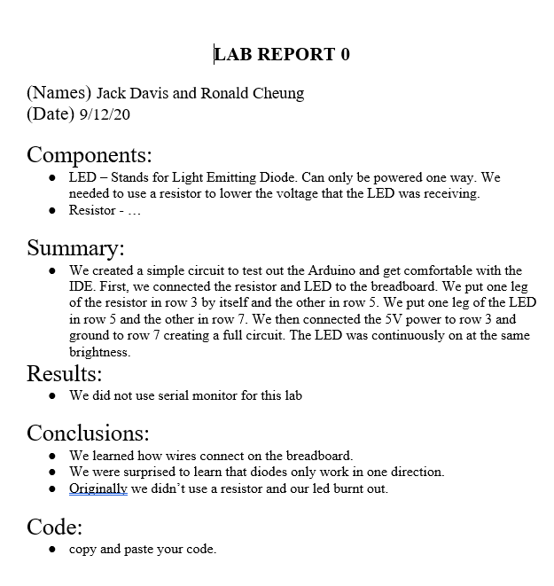
Example Lab Report

Slide 8
Policies
Work in groups of 1 or 2
Post lab questions on Piazza with lab tag (privately if you need to share code)
makeup labs are allowed (due by 11:59PM on December 11th)
You may attend a different lab section if you need to

Slide 9
Lab 1 – Setting up UnoArduSim
users of Mac/Linux will need to set up a windows VM to use UnoArduSim
Instructions provided in lab 1 instructions
users of Windows 10 can use natively without issue

